Slide 1
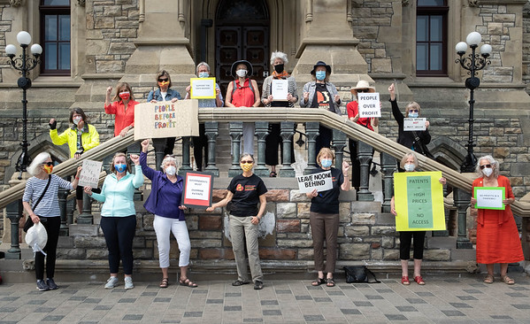
GRAN – Celebrating Our Accomplishments
Notes:
In October of 2023 GRAN received an email from a student at the North-West University (Potchefstroom Campus, North-West) in South Africa, saying how impressed she was with our organization and expressing interest in volunteering with us. She discovered our web site while doing research on older women and leadership. Elsie Bokaba is currently completing her Master of Arts in Philosophy, pursuing her interest in Environmental Philosophy, specifically in the African context, explicitly looking at the role of older women in environmental discussions and action plans. Elsie provided GRANs with a learning event in February of this year, and we have embarked with her on a path of mutual learning, she about GRAN and we about the lived experience of older women in Africa through her and her research.
And in April of this year we were contacted by a law student at the University of Calgary who said in her email, and I quote; “I've been exploring your website and resources and your mission truly resonates with me. I would love to get involved more in your organization. Veronica Leonard | She/her JD Candidate | University of Calgary
Intergenerational collaboration is key to the success of GRAN advocacy and central to our roles as older women. It is especially rewarding when young women reach out to us, to learn about our work, and to offer support.

Slide 2
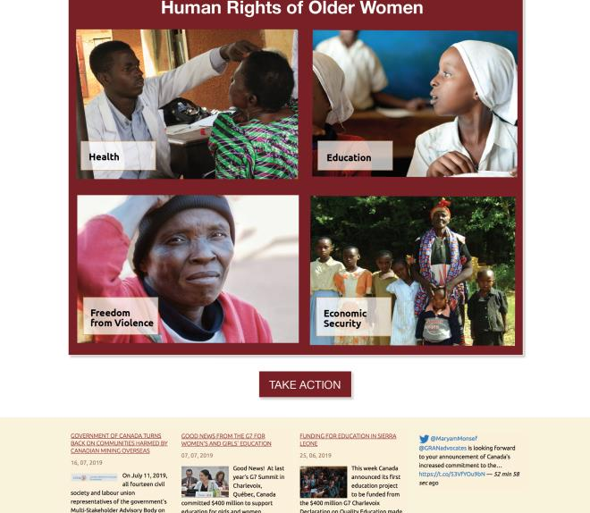
GRAN Web Site
Notes:
I’d like to start off our celebration of GRAN’s accomplishments this morning by saying Kudos to the GRAN Web Team for our wonderful web site. Special shoutout to Ruth Buckinger, GRAN member in Sackville New Brunswick, who is the master mind behind the web site, and thanks to the many GRANs who contribute to the content.
GRAN’s website is as close as we get to having an “office”, a place where the public can drop in and visit and GRAN members can stop by to pick up resources or leave us a message. Our website is rich with information about who we are, what we care about and the work we are undertaking. And it is obviously coming up in scholarly internet searches!

Slide 3
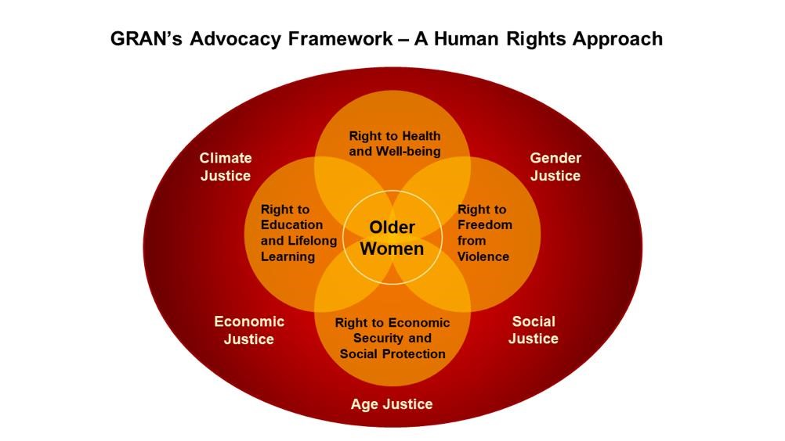
Notes:
GRAN is a nonpartisan network of volunteers from across Canada who advocate at home and internationally for program and policy changes that will promote and protect the human rights of marginalized women and communities in the Global South, with a specific focus on older women, children, youth and gender-diverse persons in the sub-Saharan African.
In 2022, the GRAN Advocacy Framework was developed to portray in a graphic manner who we are and to highlight the organizational values and principles that guide our work. At the centre of our concerns are older women, many of whom are grandmothers. Older women are among the world’s most marginalized in society and yet they are also community leaders, teachers, care providers and food producers. GRAN amplifies the voices of older women, supports community-led solutions, and partners with like-minded organizations in efforts to make the world a better place for all.
We advocate for equitable access to the basic human rights of health, education, freedom from violence and economic security. We work tirelessly to push for justice for all.

Slide 4
GRAN’s Vision and Mission
Our vision is a world where the human rights of older women, children and youth, and gender-diverse persons are recognized and protected so that they can achieve their full potential.
The mission of GRAN is to advocate for the human rights of these marginalized groups, both globally and locally.
Notes:
The GRAN vision and mission was revised in 2022 to acknowledge our continuing advocacy for the human rights of older women in sSA and to recognize that often our advocacy messages are broad and inclusive of marginalized women across the global south.

Slide 5
GRAN Organization
Steering
Committee
CT
Watch Groups
Communication
Team
Recruitment
Team
Ad hoc
Regional Groups
All of GRAN Campaign Team
Team-based organizational structure:
Steering Committee overall leadership
All-of-GRAN campaign team leads national campaign
Watch Groups source of expertise on issues
Regional Groups
Communications
Coordinating Team
Ad hoc Teams
Recruitment Team (recommended)
Notes:
There is an African proverb that many of us know well - if you want to go fast go alone; if you want to go far go together. GRAN embraces a team-based organizational structure. We have shifted in recent years from a top-down vertical organization to one depicted in this graphic. This diagram is a work in progress and is being tweaked as we gather here today.
The Steering Committee, represented by the large circle in the centre of the diagram, is the decision-making body in GRAN. The SC is composed of leaders from GRAN teams and groups including :
Watch Groups whose members research and follow their issue and are a source of expertise (you will hear more about the work of these groups later from Sharon)
Regional Groups lead the way at the local level
Communications, which is core to our work and includes our web site, the GRAN Update, GRAN email messaging, and posts on social media including FB and X (Twitter).
All-of-GRAN campaign team provides leadership to GRAN advocacy, learning events, and related collaboration with partners. Two years ago, as the result of an internal review, GRAN members recommended we focus on one campaign per year. We have take an all-of GRAN approach the last two campaigns – Health Equity and the Right to Food, and have found this approach has garnered much support among GRANs. More details to follow.
Recruitment Team – at the proposal stage right now; we would like to focus some energy in the next year on expanding our membership.

Slide 6
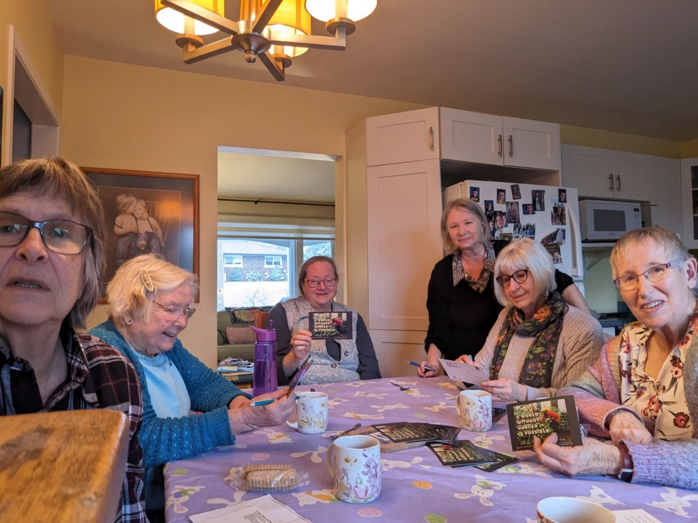
GRAN Advocacy
What we do:
Learning together
Writing letters
Signing petitions
Meeting with MPs
Sending postcards
Public engagement
Demonstrations and rallies
Notes:
GRAN advocacy takes many forms, including many letter writing get togethers around a kitchen table.
Learning about the issues and solutions is an ongoing activity which is facilitated by learning events and email news posts
Signing petitions
Flooding Parliament Hill with postcards
Hosting public engagement events,
Demonstrations and rallies
Much of our advocacy occurs in collaboration with our partners and allies.

Slide 7
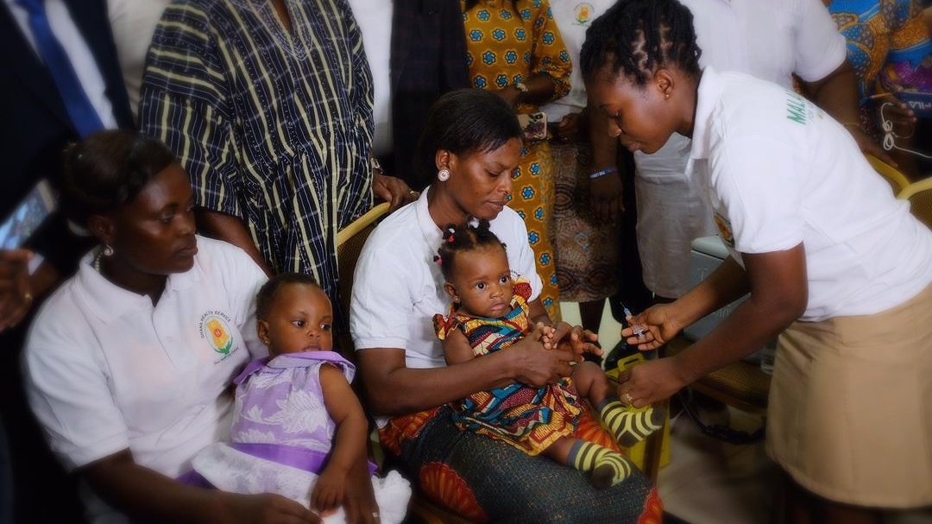
Right to Health and Well-being
Notes:
Advocating for access to affordable life-saving health care has been at the core of GRAN’s mandate since our beginning.
Recently, climate change and conflict have had a huge impact on health conditions in Sub-Saharan Africa and the rest of the Global South. Malnutrition rates have greatly increased as people face many challenges to obtain nutritious food. Cholera cases have risen due to lack of access to clean water. Malaria spread is adversely affected by thriving mosquitoes where flooding occurs.
GRAN advocates for equitable access to prevention, diagnosis, and treatment, with affordable medicines.

Slide 8
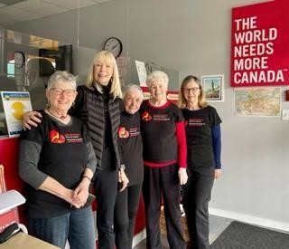
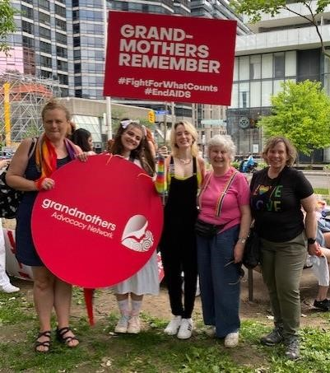
Right to Health and Well-being
Notes:
The first all-of-GRAN campaign, Health Equity: Fair Global Access to Lifesaving Medicines/Vaccines was undertaken from April to September of 2022. At this time the COVID-19 pandemic was having a devastating impact on HIV, TB, and malaria programs in sub-Saharan Africa due to disruptions in health services and supply chains. And Canada’s commitment to support access and delivery of COVID vaccines to low-income countries was critically important to save lives.
The Health Equity campaign was a collaborative effort with partners. Collectively we advocated for a 30% increase in Canada’s contribution to the Global Fund to Defeat HIV, TB and Malaria. (photos)
The Health Equity campaign was a resounding success! GRANs across the country celebrated Canada’s $1.2 billion pledge to the Global Fund, the figure we had been advocating for, representing a 30% increase from Canada’s previous contribution. These dollars were targeted to go to treatment and prevention for TB, HIV and malaria and to build resilient and sustainable health systems in more than 100 countries.

Slide 9
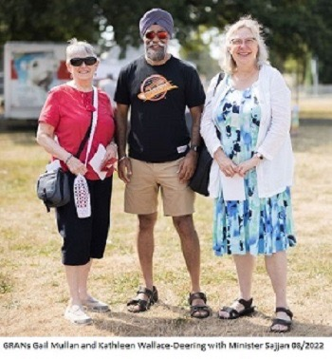
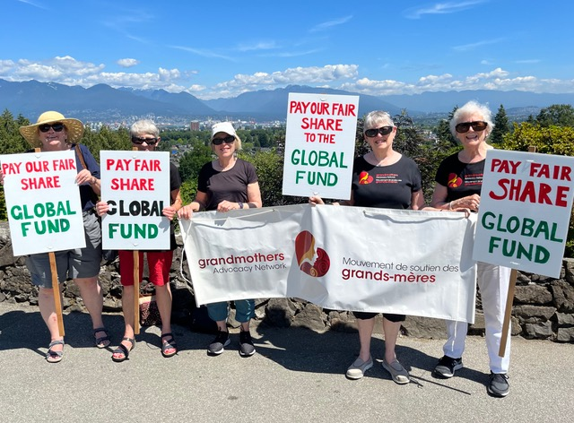
Right to Health and Well-being
Notes:
The Health Watch Group has seen other major successes:
In 2019 GRAN worked with other civil society organizations advocating to the Canadian government for an early and ambitious contribution to the Global Fund to Fight HIV, Tuberculosis and Malaria. GRANs were delighted when the Canadian government announced a contribution of $930.4M to the Global Fund to support its work from 2020 to 2022. This was an increase of 15.7% over levels in the previous round of replenishment.
With the outbreak of the COVID 19 pandemic GRAN shifted its efforts to having a vaccine available and free to all. We joined a global movement, working tirelessly to ensure publicly funded diagnostic tools, treatment and the COVID-19 vaccine would be sustainably priced, available to all and free at the point-of-delivery. The team called on Prime Minister Trudeau, ahead of the meeting of the G7, to act on his government’s stated commitment to share vaccines with COVAX — the global COVID vaccine distribution initiative. Their advocacy included creation of a video message to the Prime Minister that generated much activity on Twitter and YouTube;
And success! In September 2021, GRANs worked with partners Results, ONE, Global Citizen and members of Cooperation Canada in a campaign asking Canada to invest 1% of its COVID spending on a global response. The campaign resulted in Canada investing $400M in humanitarian aid and $220M in COVAX to help with the equitable distribution of vaccines.

Slide 10
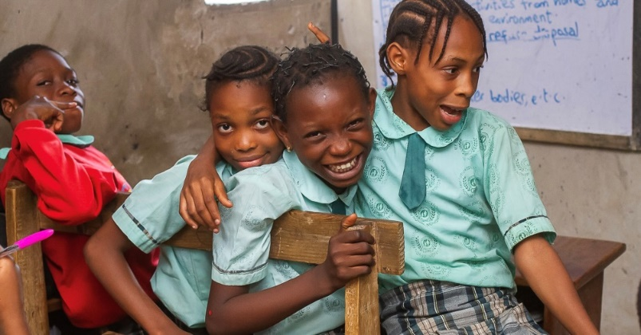
Right to Education and Life-long Learning
Notes:
Education is a fundamental human right that is being left unrealized in many lower-income countries, particularly in sub-Saharan Africa, and especially for girls. Education transforms lives in many ways.
GRAN works with partners in advocating for increased funding to the Global Partnership for Education which coordinates a global effort to deliver a good quality education to all children.
In 2019 GRANs actively campaigned for a generous contribution from the Canadian government for the Global Partnership for Education replenishment. And success! Our efforts were rewarded when Canada doubled its contribution to $180 million for the period 2018 to 2020.

Slide 11
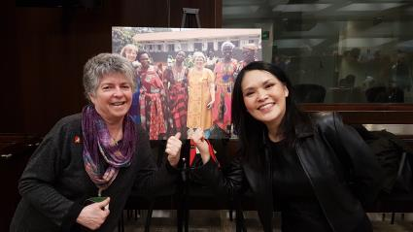
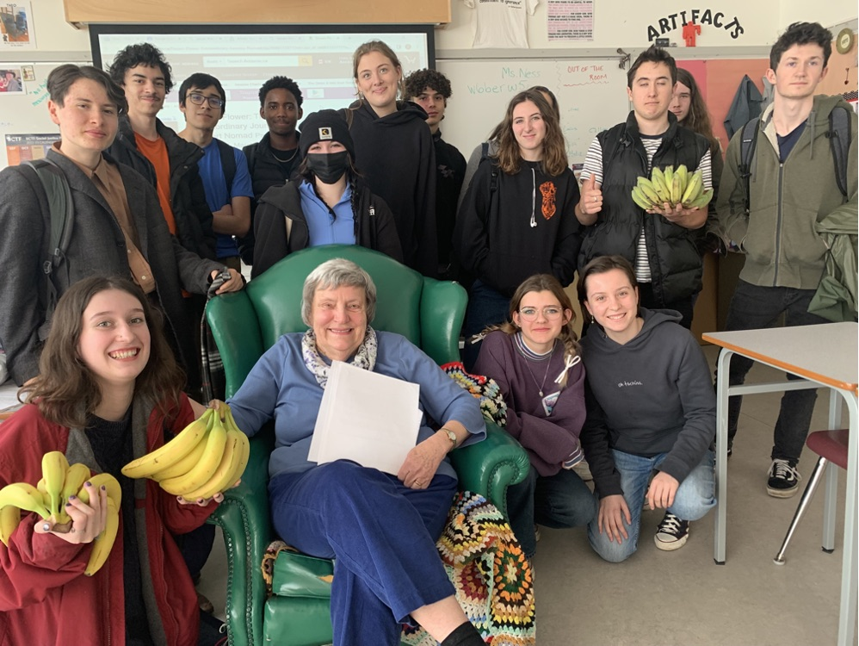
Right to Education and Life-long Learning
Notes:
In 2023, GRANs, in collaboration with partners from the Canadian International Education Policy Working Group, signed a petition and took to social media calling on the Government of Canada to fulfill their promise to increase international assistance, including dedicating funding to global education. In February, success! We celebrated as Canada pledged $87.5 million over four years (2023 to 2026) to Education Cannot Wait (ECW), to support millions of crisis-affected children in accessing quality education.

Slide 12
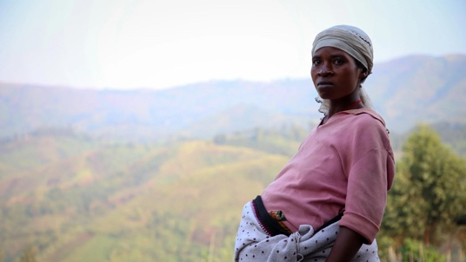
Right to Freedom from Violence
Notes:
For the past seven years, GRANs across the country have participated in the United Nations Orange the World Campaign:16 Days of Activism to End Gender-Based Violence. Gender equality is not only a fundamental human right, but a necessary foundation for a peaceful, prosperous, and sustainable world.

Slide 13
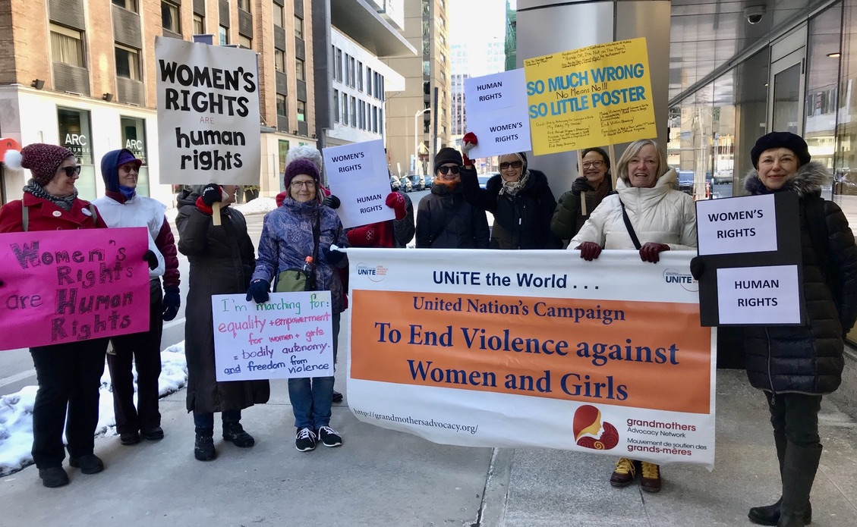
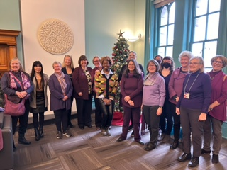
Right to Freedom from Violence
Notes:
Violence against women and girls is a human rights violation. One in three women worldwide experience physical or sexual violence, most often perpetrated by an intimate partner. The 16 Days of Activism is a time to galvanize action to end violence against women and girls everywhere.

Slide 14
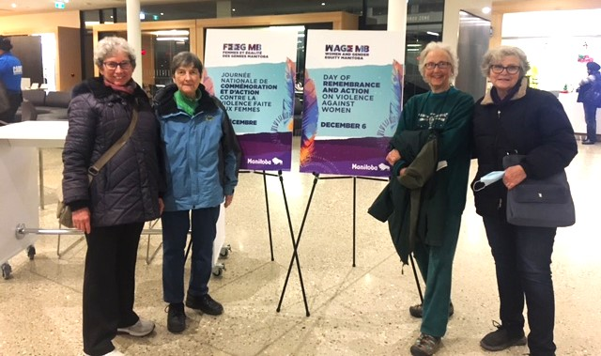
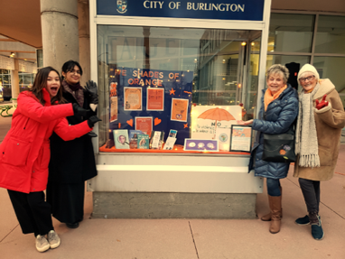
Right to Freedom from Violence
Notes:
GRANs arranged for their mayors to issue proclamations, held candlelit vigils, organized educational displays and facilitated discussions regarding the need to end violence against women. They decorated their communities with giant orange bows and distributed orange ribbons and pamphlets on street corners, in libraries and to family and friends to raise awareness.

Slide 15
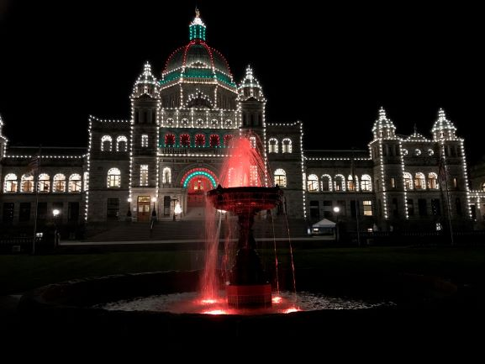
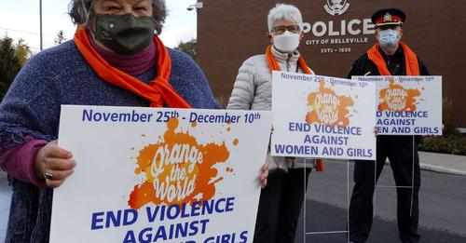
Right to Freedom from Violence
Notes:
The leadership provided by GRANs across Canada included lighting up city halls and parliament buildings and rallying with MPs and municipal leaders, and showing solidarity with their local police.

Slide 16
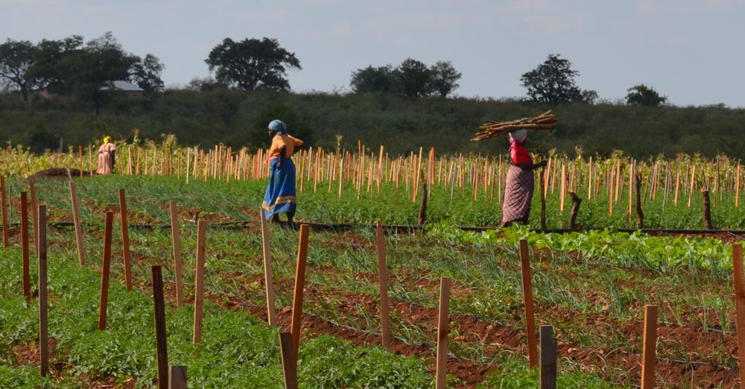
Right to Food
Notes:
The global hunger crisis was chosen in October 2022 as the focus for the second all-of-GRAN campaign. This has been a successful campaign on so many levels, and will be the focus of a presentation by Bunny Keeley and Diane Scaletta this afternoon.

Slide 17
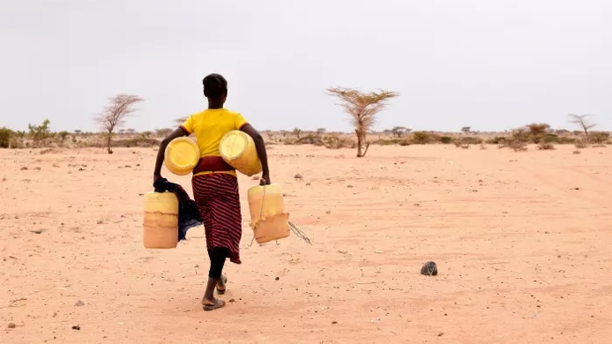
Climate Justice
Notes:
In January 2020, GRAN decided to pursue advocacy actions directed at the climate crisis, recognizing the impacts of the changing climate as a broad and significant cross cutting issue that effects all of GRAN priority areas. GRAN recognizes that extreme weather events related to the rapidly changing climate most significantly affect people in the global south, especially older persons, women, children, persons with disabilities, and those who struggle to provide the necessities of life for themselves and their families. Countries that have done the least to cause climate change are those who are impacted the most.

Slide 18
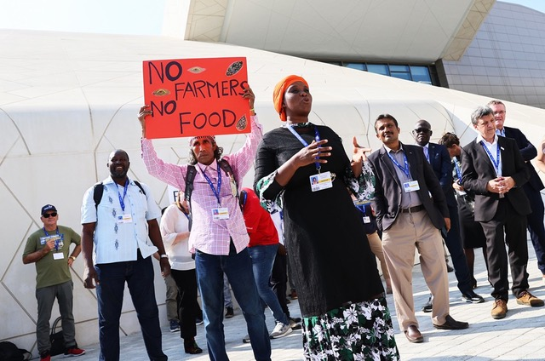
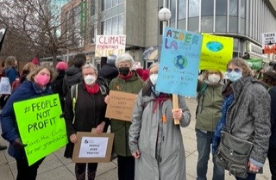
Climate Justice
Notes:
Under the Paris Accord wealthy countries, including Canada, set a goal of mobilizing $100 billion annually in climate finance by 2020. GRAN worked with its partners at the Canadian Coalition for Climate Change and Development in advocating for Canada to contribute its fair share to this international commitment. GRAN has also worked with partners at Climate Action Network in amplifying the voices of leaders from the Global South in calling for recognition of the disproportionate impact of climate change on their countries, and the desperate need for support in their recovery efforts.

Slide 19
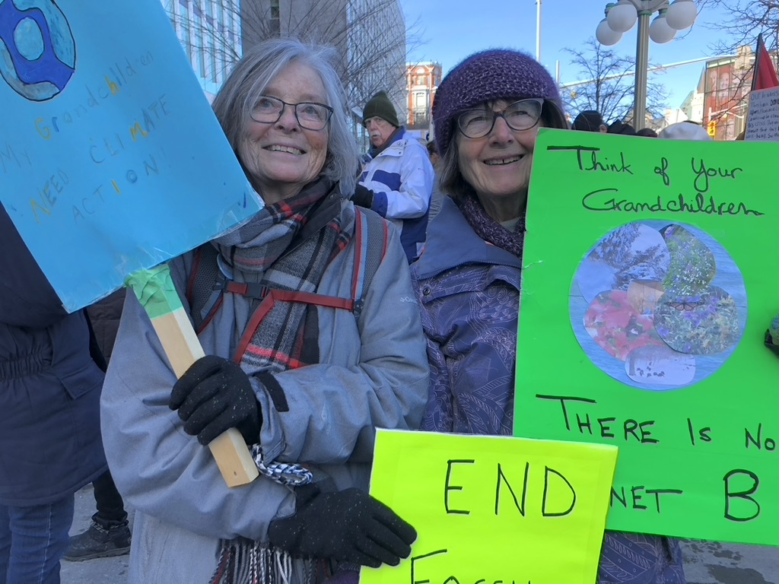
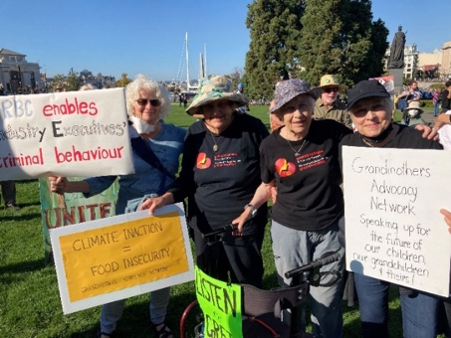
Climate Justice
Notes:
And success! At the G7 Summit in June 2021, Canada committed to double its international climate finance, to $5.3 billion over the next five years, including increased support for adaptation and for women’s organizations providing leadership locally.
And, after decades of collective advocacy by lower-income countries and small island states, a Loss and Damage Fund was successfully established in November 2023. However, much work remains.

Slide 20
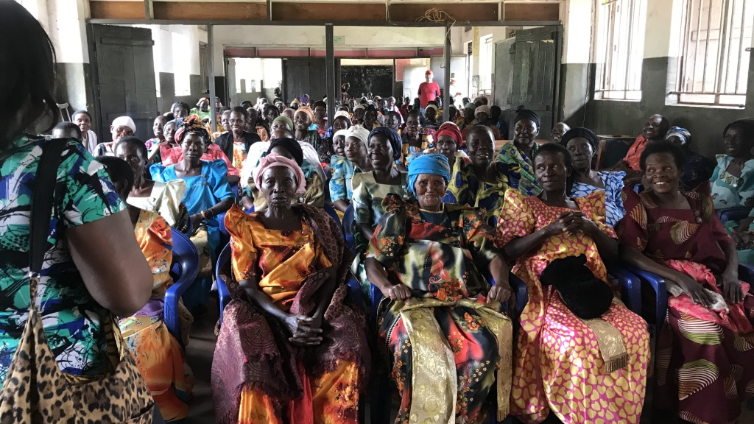
UN Convention on the Rights of Older Persons
Notes:
A Convention on the Rights of Older Persons would provide legal protection for the human rights of older women, those who are the focus of GRAN advocacy. GRAN has followed this crucial instrument for the protection of older persons’ rights since 2019, collaborating with the Global Alliance for the Rights of Older. Persons. This included virtually attending the 11th Annual Session of the United Nations Open-Ended Working Group on Aging in 2021 and participating virtually in the global Aging with Rights Campaign.

Slide 21
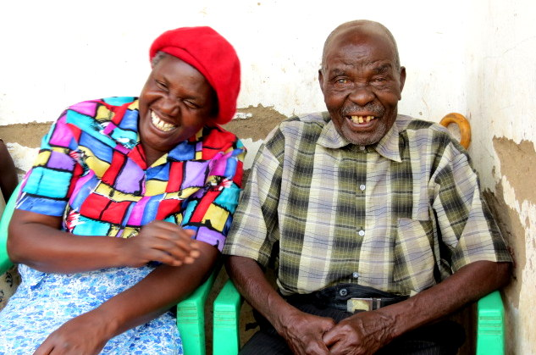
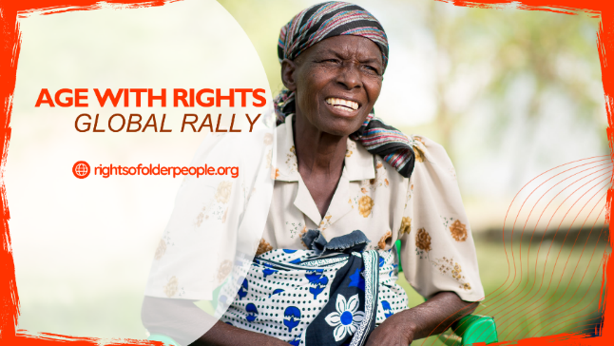
UN Convention on the Rights of Older Persons
Notes:
In November GRAN participated in a survey by the Open-Ended Working Group on Aging of member groups. The purpose of the survey was to identify gaps in 14 areas. It is hoped that responses and recommendations from this process will be consistent with the message that the current human rights framework does not adequately address and protect the rights of older persons and that a new legally binding UN convention is the best way to address this.

Slide 22
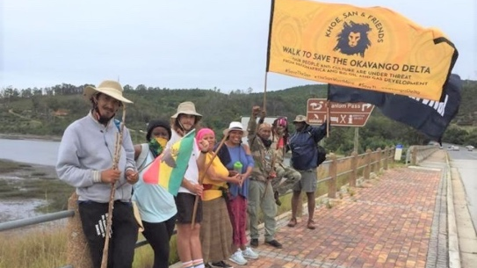
Mining Justice
Notes:
Well-documented widespread human rights abuses have been associated with the activities of many Canadian mining companies abroad including:
Gender-based violence;
Seizure of land and water without local consultation.
Serious illness or death resulting from toxic chemicals in the air, land and water;
Injuries or death of peaceful protesters; and
Destruction of cultural values and the social fabric of communities.
These companies must be held accountable for their actions in the communities in which they operate. At risk are the human rights of the local people and potentially devastating environmental impacts to this fragile ecosystem, with threats to both water security and biodiversity.
GRAN advocacy has included collaborating with partners and the Indigenous people of the Okavango Delta located in Botswana and Namibia as Vancouver based oil company, Reconnaissance Energy Africa Ltd. (ReconAfrica), drilling activities threatens the lives of small holder farmers including a sensitive water supply, displacement from their land as well as the fragile ecosystem and rich biodiversity of the area.

Slide 23
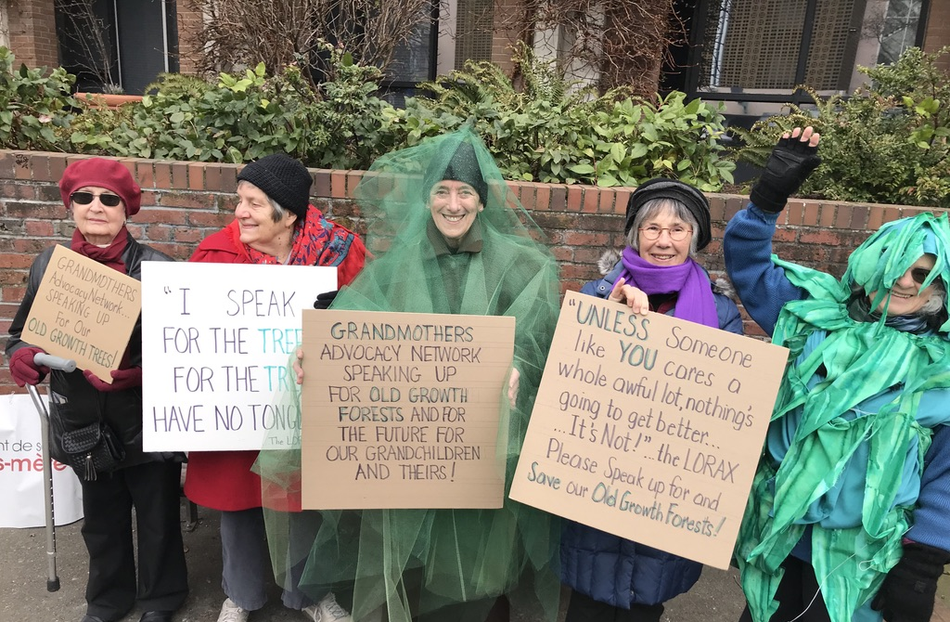
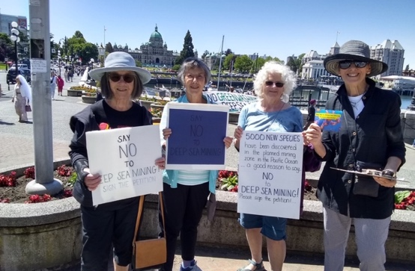
Mining Justice
Notes:
In April 2019 the Government of Canada appointed the first Canadian Ombudsperson for Responsible Enterprise (CORE). There were hopes that this position would begin to address the many human rights abuses of the Canadian extractive industries operating abroad, but her mandate fell far short of the independent watchdog the government had promised. GRAN continues to work with many partners to create an independent watchdog to hold Canadian mining companies accountable for their practices abroad.

Slide 24
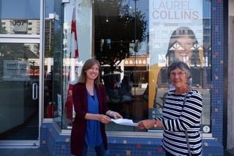
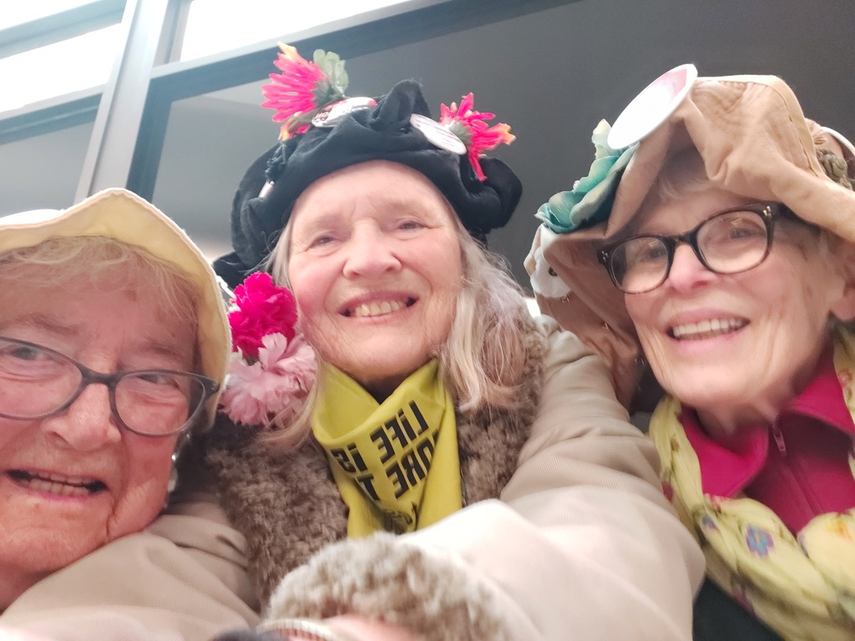
Mining Justice
Notes:
We are seeing progress in the area of mining justice with the increase in lawsuits and investigations of human rights abuses by Canadian mining companies operating abroad. We are also heartened by the proliferation of corporate due diligence laws being passed in Europe, the number of articles in newspapers concerning allegations of human rights abuses, the need for more regulation, and overall growing public awareness that change is needed in the mining industry.

Slide 25
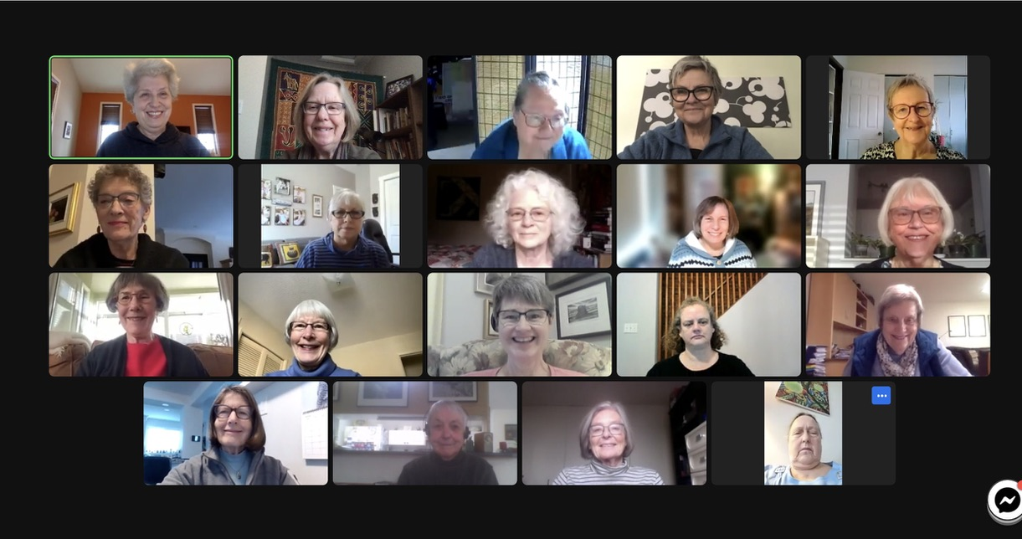
GRAN’s Strengths - Teams
Notes:
In closing I want to briefly highlight a few of GRAN’s strengths.
The first strength I would like to flag is teamwork. GRAN is composed of many teams: six at the national level, 10 regional teams and many more local teams. At last count GRAN has just a little over 300 members across the country. This is a photo of the GRAN Steering Committee members.
GRAN’s accomplishments are astonishing when we consider that ours is a completely volunteer movement, with members widely spread across the country. Without the passion and commitment of our members, none of this would be possible. We are proud of our organization and the important work for justice and human rights we undertake, and grateful for the community we have built together. A deep and sincere thank you to each GRAN member.

Slide 26
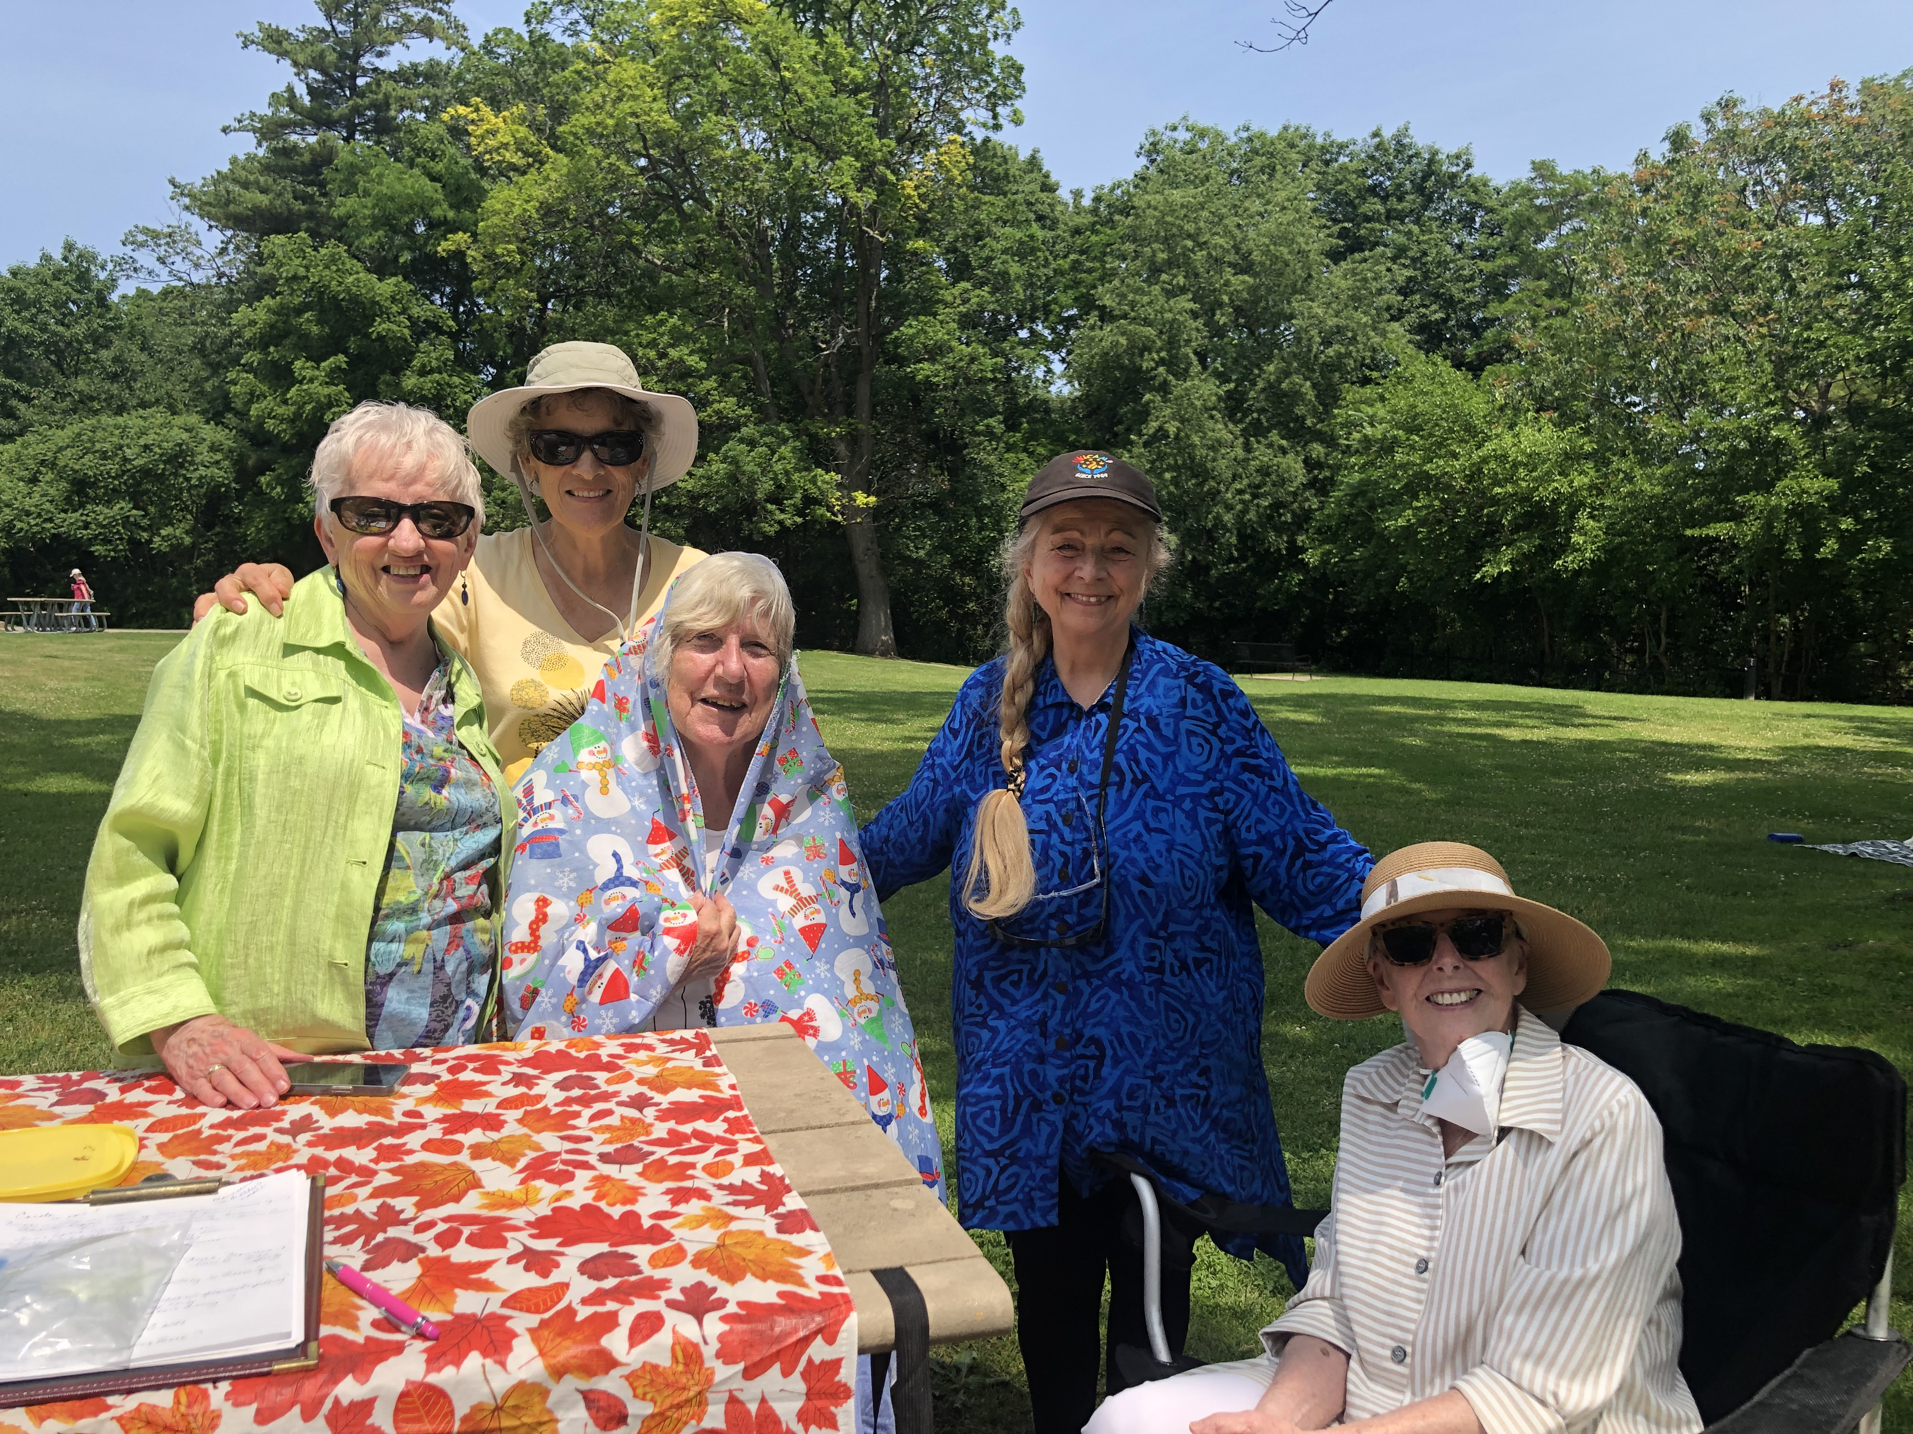
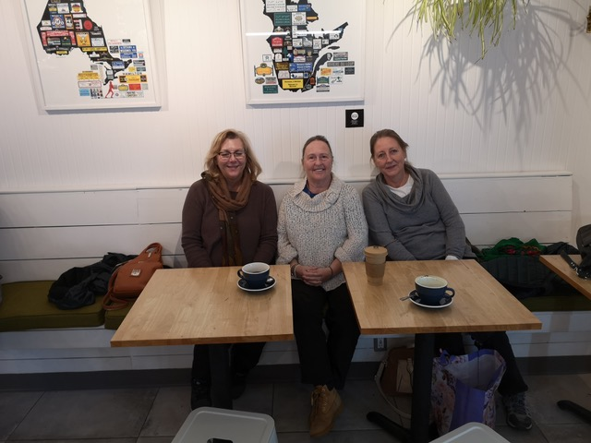
Teams
Notes:
GRAN is in a unique position among Canadian Civil Society Organizations as a national volunteer network of older women with life experience that motivates us to advocate for the human rights of our sisters around the world. GRAN has garnered much respect across the civil society community in Canada and among parliamentarians. This is in thanks to our strong roots, as you will hear this afternoon, and the ongoing passion and dedication of time and energy of our members.

Slide 27
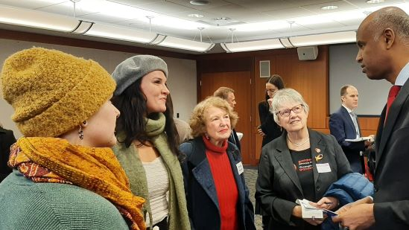
GRAN Strengths – Meeting with MPs
Notes:
The second strength I want to highlight is the building of relationships with MPs, Cabinet Ministers and Parliamentary Secretaries. These relationships and communications are one of the most powerful aspects of our advocacy. Our organization is respected among parliamentarians for our non-partisan and thoughtful conversations, and the offering of solutions. For new parliamentarians perhaps meeting a group of older women advocates is still a bit of a novelty.
I want to recognize the efforts of two of our partners who provide opportunities to collaborate in meeting with MPs. Firstly one of our newer partners, the British Columbia Council for International Cooperation, who organized meetings with Minister Hussen this spring in Vancouver and Victoria. Thanks to the GRANs who at very short notice met with Minister Hussen. These meetings were significant opportunities for GRAN to profile the Right to Food campaign with our new Minister of International Development. .

Slide 28
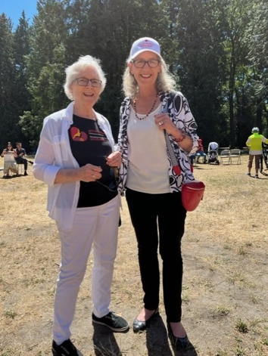
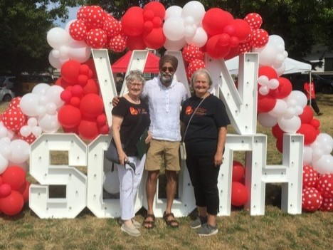
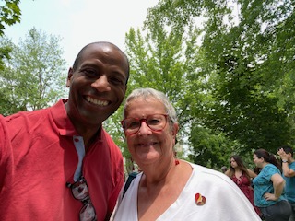
Meetings with MPs
Notes:
I also want to recognize Cooperation Canada, of which GRAN is a member host the Annual Hill Days where partners team up to meet with MPs. GRAN has participated in Hill Days for many years.
Most importantly I want to recognize and to thank the many GRANs who meet, and develop relationships, with their MPs. MPs are especially interested in hearing from us as constituents, providing us with the opportunity to influence the message they take forward to Parliament Hill. You can see from this slide we had a busy summer in 2023 attending MP events.
And this leads me to the last strength of our organization that I want to recognize – partnerships.

Slide 29
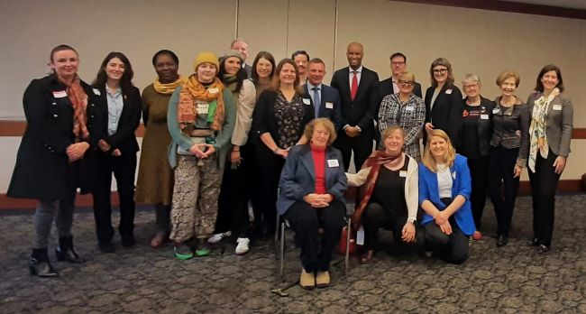
GRAN Strengths - Partnerships
Notes:
GRAN values partnerships and alliances with like-minded organizations, and the opportunities this opens up to collaborate in shared advocacy efforts. Many voices delivering a similar message, identifying a priority requiring the attention of our political leaders garners attention, and has a better chance of success.

Slide 30
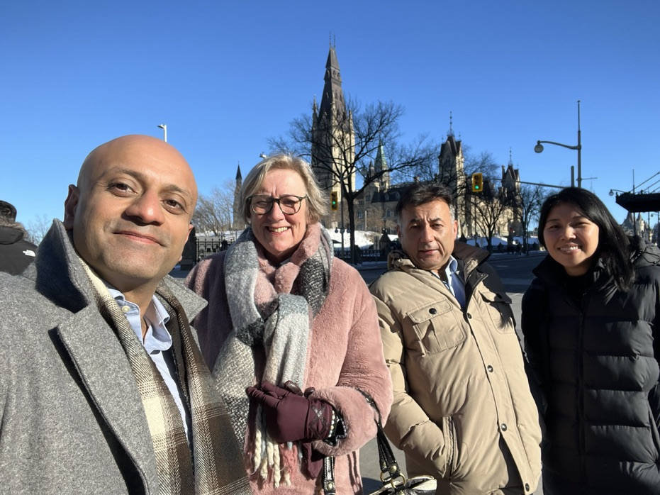
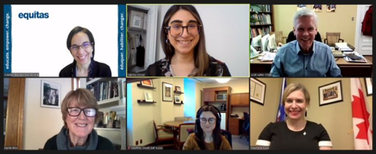
Partnerships
Notes:
GRANs work closely with a number of well-respected organizations who hold values similar to our own including ONE Canada, Results Canada, the Canadian Foodgrains Bank, Canadian Coalition on Climate Change and Development, Climate Action Network, Canadian International Education Policy Working Group and many others.
Upon our request a few of our partners and friends of GRAN have each recorded a short video message for Hello Friends that we would like to share with you now. I will now turn the event over to Cathy and Stella who will facilitate the technology in sharing messages from Results, ONE Canada, Canadian Foodgrains Bank and MP Anita Vandenbeld.
Again, thanks to all GRANs who make our collective work possible.

