Slide 1

We can end child hunger

Slide 2
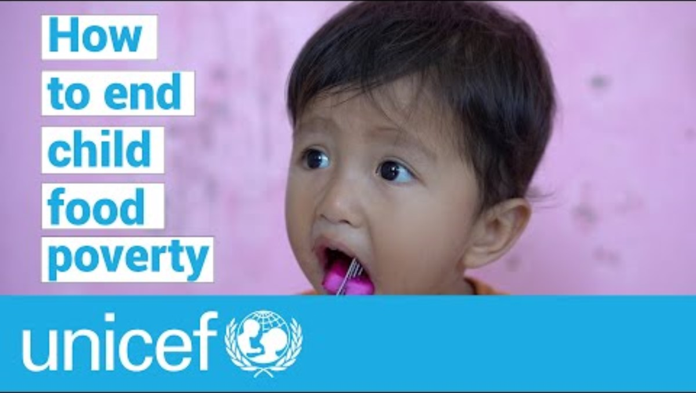
Notes:
This is a playable video as long as you have internet access. Just hit the arrow in the middle of the image.

Slide 3
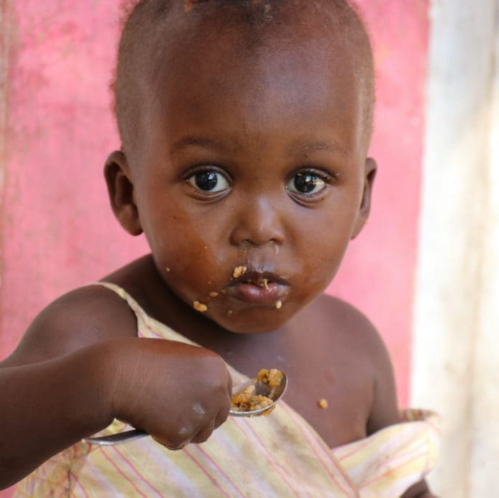
How child hunger is different
Malnutrition is devastating for children, especially those under five – crucial developmental years
Affects cognitive development, growth, survival
Shows up as wasting, micronutrient deficiencies, and stunting
Weakens the immune system
Photo Credit: World Food Programme
Notes:
Malnutrition most devastating for children, especially those under five
In these crucial years, hunger irreparably harms a child’s future
And can cause permanent damage to cognitive development, physical growth and their very survival
Malnutrition shows up in children as wasting, micronutrient deficiencies and stunting.
It weakens the immune system making them more susceptible to malaria, diarrhea, cholera, pneumonia and death
(Photo: UNICEF)

Slide 4
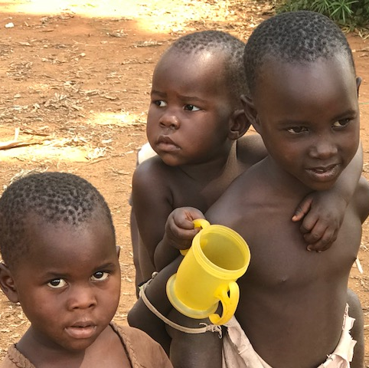
More than 1 million children are affected
1 million children under 5 die of severe wasting yearly
146 million children suffer from stunting
2/3 of world’s children under 5 living in moderate/severe child food poverty
45% of deaths in children under 5 caused by malnutrition
Most severe in sub-Saharan Africa and south Asia
Notes:
Each year, over 1 million children under 5 die of severe wasting.
Over 146 million children suffer from stunting.
2/3 of the children under 5 are living in moderate to severe child food poverty’
Poor nutrition causes 45% of deaths in children under 5. That’s 3.1 million children
Child hunger most sever in sub-Saharan Africa and south Asia
(Photo: Kids lining up for food in Jinja)

Slide 5
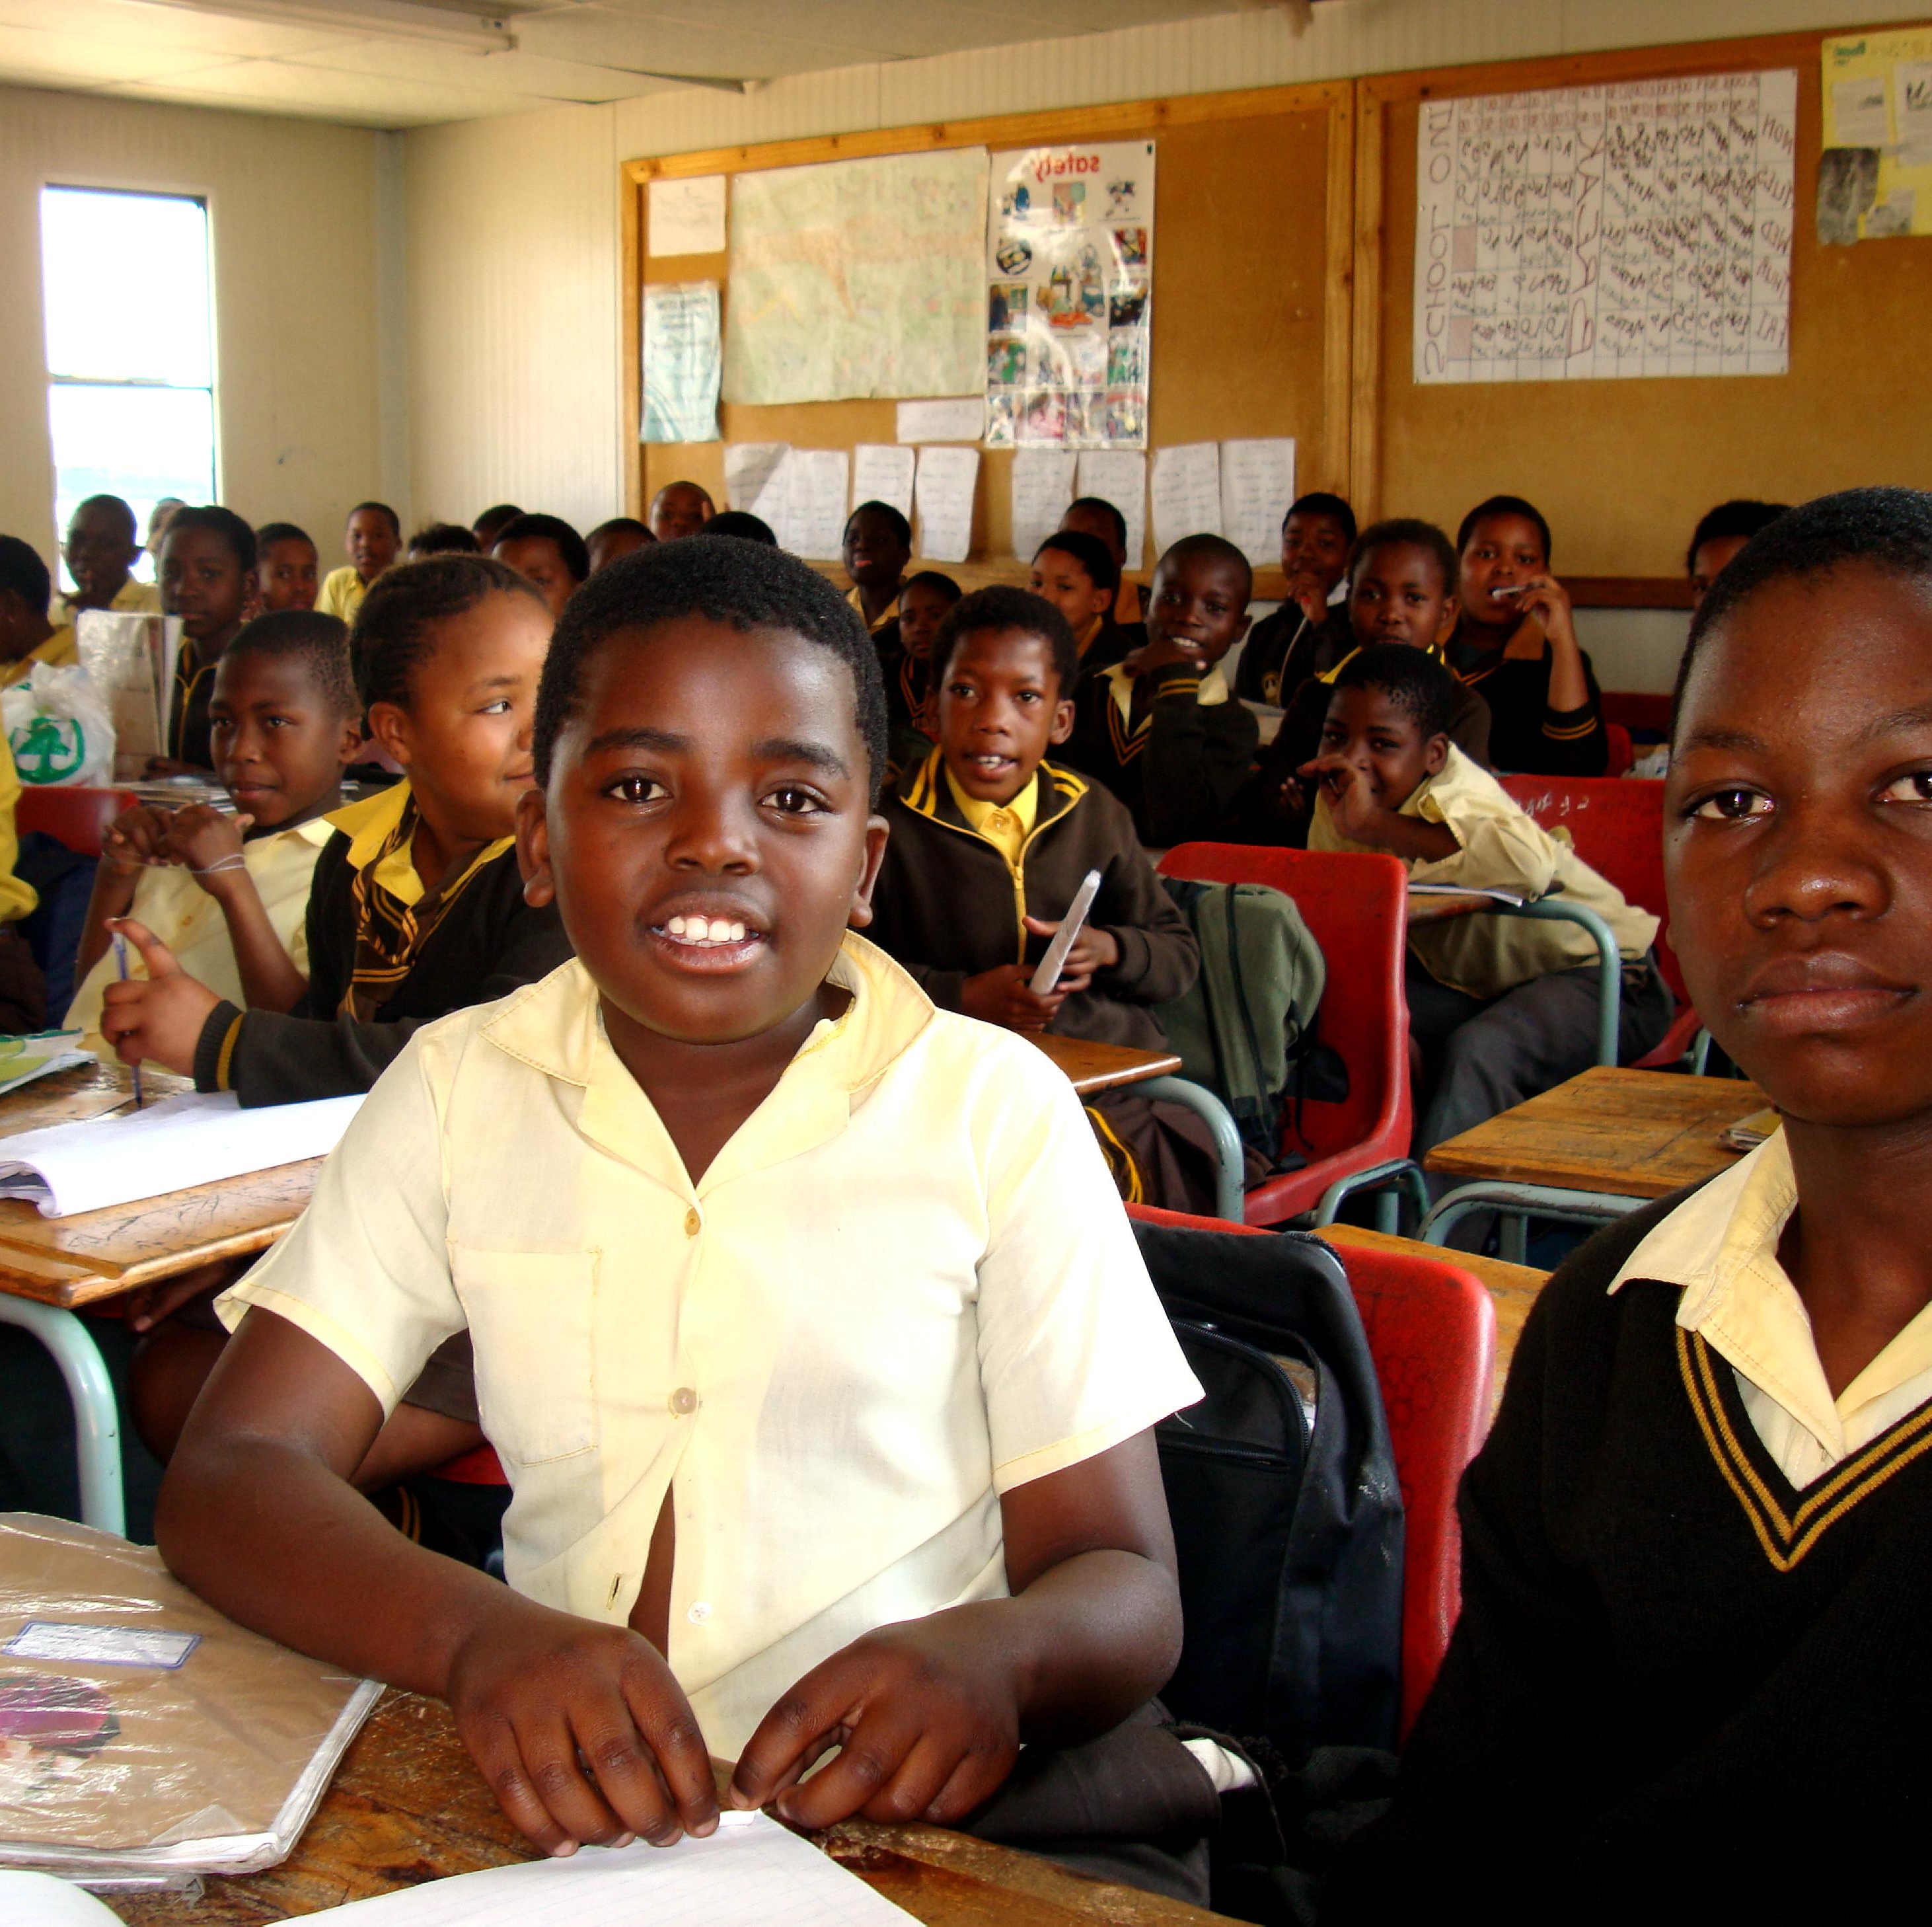
More impacts of hunger
Hungry children struggle to concentrate in class
And miss school due to sickness
Children are taken out of school to contribute to family income
Children may end up doing dangerous work
Many girls are forced into early marriage
Photo credit: Pixnio
Notes:
School-aged children suffering from malnutrition means they can’t concentrate in class and often miss class due to sickness.
Families may be forced to remove a child from school so they can work to contribute to the family income
Children may be driven into dangerous labour situations such as child slavery, prostitution or recruitment as child soldiers
Many girls are forced into early marriage, so there is one less mouth to feed at home.
Pixnio

Slide 6

Children in Canada also face chronic hunger
Chronic hunger in Canada is deep-rooted and persistent
Main cause of hunger is poverty
Poverty not a choice people make, but a reality they live
Children, Indigenous peoples, new immigrants, single parents, people with disabilities are most vulnerable to chronic hunger
Photo credit: change.org
Notes:
Chronic hunger in Canada is deep-rooted and persistent. The main cause of hunger is poverty.
While some conventional wisdom suggests otherwise, poverty is not a choice people make, but a reality they live.
Children, Indigenous peoples, new immigrants, single parents, people living with a disability, and unattached people aged 45-64 are most vulnerable to chronic hunger.
Photo courtesy change.org

Slide 7

Access to nourishing food is every child’s human right
Children don't just need food They have a right to it
Hunger is preventable
Child deaths from malnutrition are preventable
This is not just a hunger crisis but a failure of priorities
Image credit: humanrightscareers.com

Slide 8
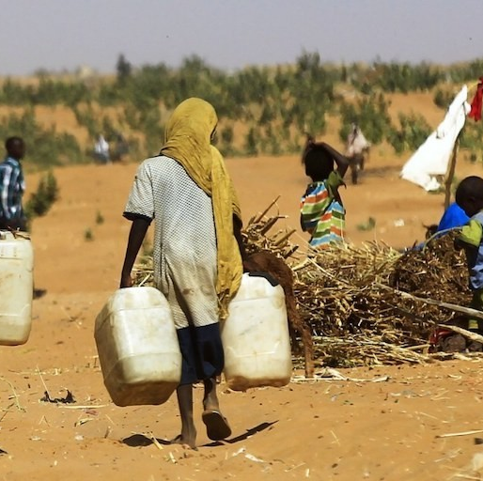
What is driving child hunger
The world is experiencing an unprecedented hunger crisis, driven by:
Armed conflict
Poverty
Rising food costs
Continuing economic fallout from the pandemic
Gender inequality (women and girls eat last and least)
Climate change causing extreme weather events – droughts, flooding – impacting livestock, soil health, human health
Photo credit: issafrica.org
Notes:
Photo courtesy of issafrica.org

Slide 9
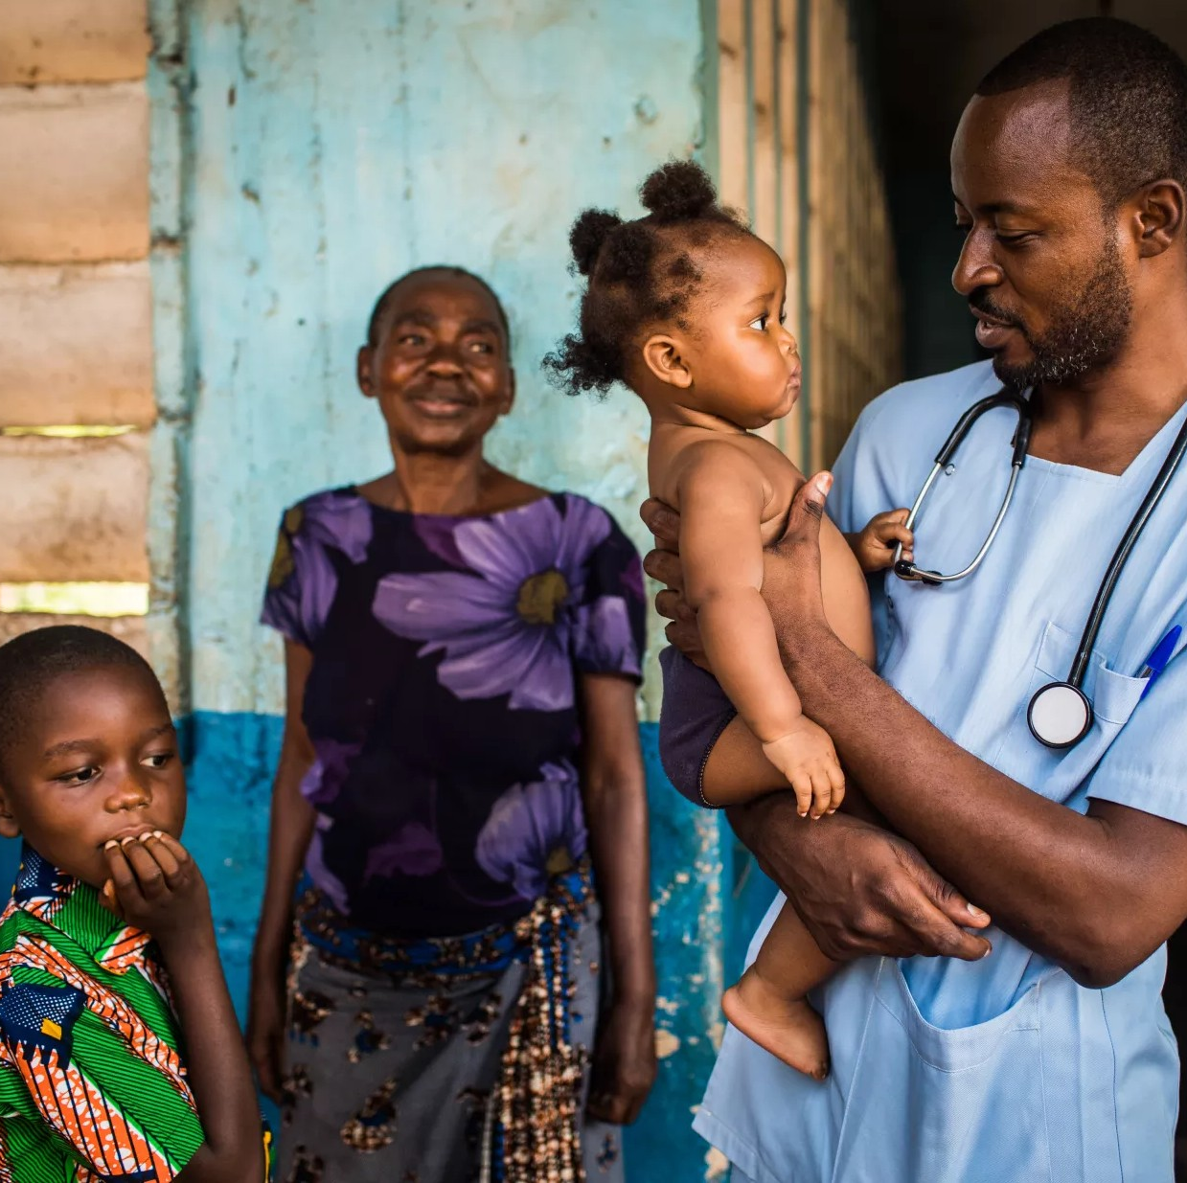
Child hunger is not just a food issue
Ending child hunger and malnutrition will require efforts in many areas:
health care
water, sanitation and hygiene
education
gender equity
poverty alleviation
sustainable agriculture and food systems
climate adaptation
Photo credit: UNICEF

Slide 10
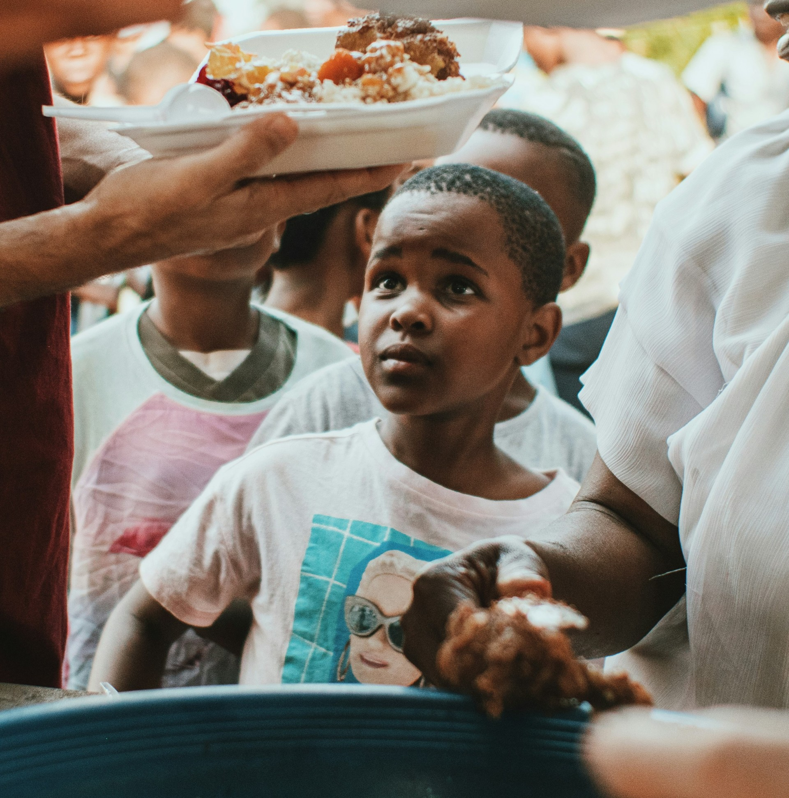
What can Canada do?
Increase international assistance overall
Commit $750 M over 5 years to nutrition support
Scale up funding for emergency humanitarian response
Support nutrition counselling programs (esp. breastfeeding)
Invest in community and primary healthcare
to support maternal and child health
to increase vaccination coverage
Support access to healthy food, safe water, sanitation, and hygiene
Photo credit: Michael Ali
Notes:
Canada can make a difference and save lives through international assistance:
Invest $750 M over 5 years in nutrition-focused initiatives (as of February 2025, Canada committed $360 M over 6 years
Scale up funding for emergency humanitarian response
Support nutrition counselling programs for infant and child feeding (especially breastfeeding)
Invest in community & primary healthcare
To prevent, detect & treat childhood illnesses
Increase vaccination coverage
Improve access to healthy food, safe water, sanitation and hygiene

Slide 11

What individuals can do
In Canada, donate volunteer hours, food, $$ to food banks, school food programs
Donate to global development and humanitarian organizations
Learn more about the issue
Help build public awareness about child hunger
Advocate for policies, programs and investments to help end child hunger at home and abroad
Notes:
Give – volunteer hours, donations of food or $$ to local foodbanks and school breakfast programs
Support development and humanitarian organizations working on the frontlines of the global hunger crisis
Learn more about the issue
Help build public awareness about child hunger and the urgent need for action at home and internationally
Advocate with our government representatives for policies, programs and investments to help end child hunger at home and abroad

Slide 12
Together, we can end child hunger!
The Grandmothers Advocacy Network (GRAN) is a non-partisan network of volunteers working together across Canada to advocate at local, national and international levels. Our vision is a world where the human rights of older women, children, youth, and gender-diverse persons are recognized and protected, so that they can achieve their full potential.
This year GRAN is focused on child hunger in our advocacy on the Right to Food. You can sign up at https://grandmothersadvocacy.org to receive email updates on upcoming learning events, advocacy actions, and news articles on child hunger. Let’s do this work together.

